Slide 1

End Of The 747 Line And Aircraft Value Update
Doug Kelly, Senior Vice President – Asset Valuation
AVITAS, Inc.
Cargo Facts Webinar
August 26, 2020
Notes:
1

Slide 2

Agenda
1
Current Situation
2
747 End of Production
3
Historical Values
4
Current and Future Values

Slide 3
TSA Traveler Checkpoint Numbers – 2019 vs 2020
Currently 70% drop in travelers from last year
2019
2020
Source: Transportation Security Administration

Slide 4
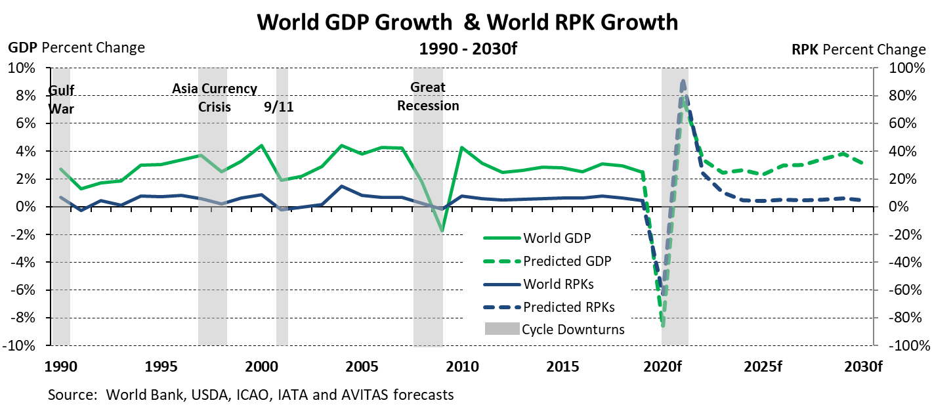
This Cycle Vs Past Cycles

Slide 5
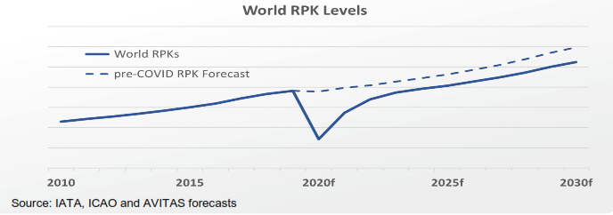
Passengers Return To 2019 Levels By ~2023

Slide 6
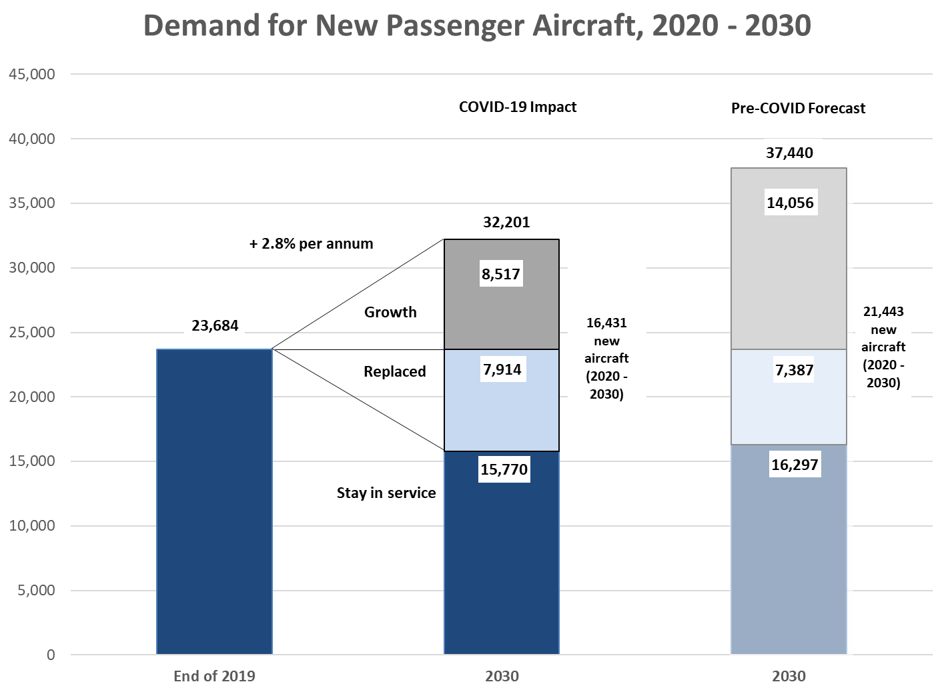
Forecast Demand Down 5,000 Aircraft vs. Pre-COVID Forecast

Slide 7
Trade War Was Impacting Air Cargo Before Pandemic
U.S. announced 10% tariff on China beginning end of September increasing to 25% by end of 2018. The increase was postponed until May 2019.
Beginning of Trade War

Slide 8
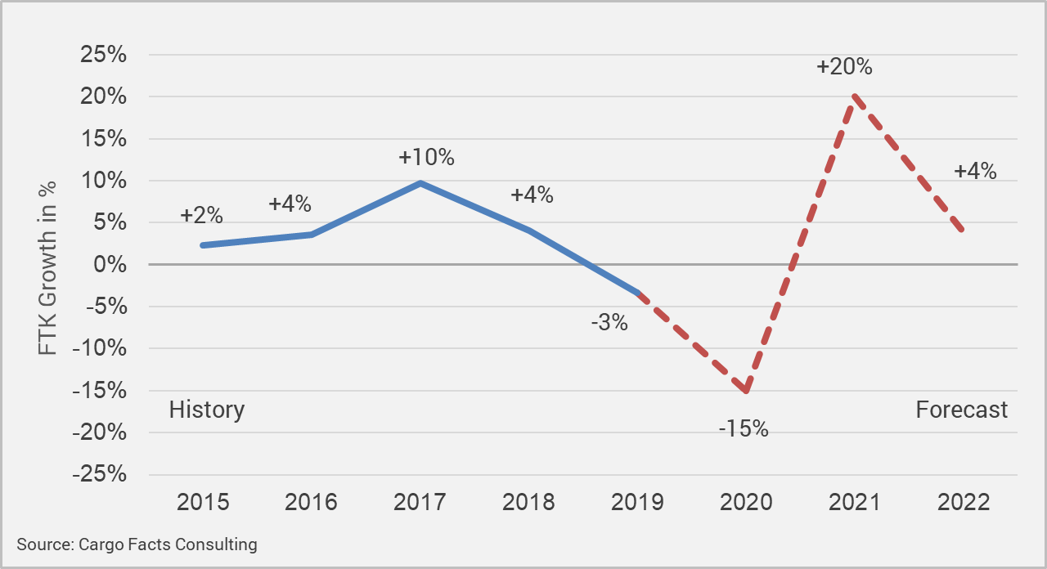
Forecast Is For Air Cargo To Rebound Sharply In 2021
From Cargo Facts Consulting: Freighter Forecast 2020-2039 (published April 2020)
Drivers of Air Cargo in 2020/2021
Lockdowns, Virus case numbers, hospitalisations and death
Stimulus– which parts of the economy are receiving Government assistance and when
Spending – Consumer and Government, but probably not business investment
B2C acceleration and the paralysis of brick-and-mortar retail
Supply Chain Disruptions – due to lack of global synchronisation and low inventories
Passenger capacity – speed of recovery

Slide 9
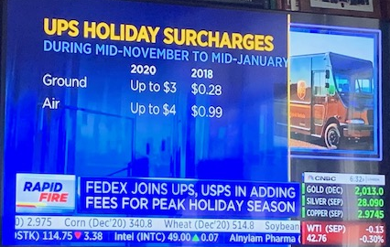
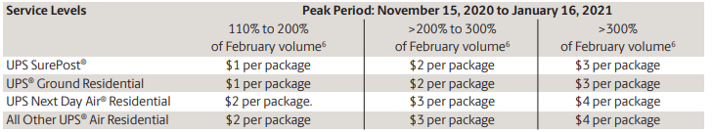
Business Is Booming For Express Shippers – Rates Are Going Up
Sources: CNBC and UPS.com

Slide 10

Boeing introduced the 747, “the Queen of the Skies”, in 1969. After more than 50 years in service, Boeing will cease production in 2022.
Photo: Boeing

Slide 11
What will happen to 747 values?

Slide 12
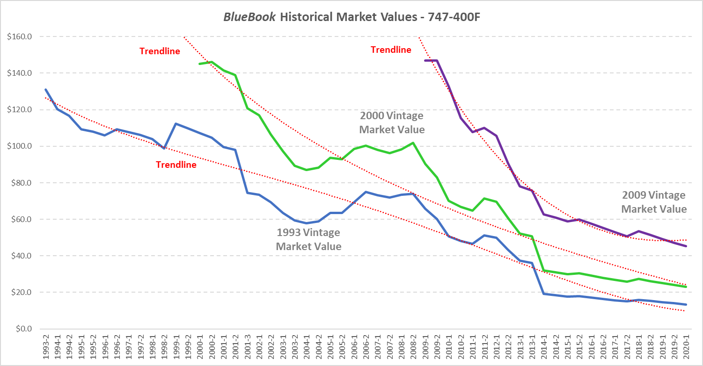
Historical BlueBook Market Values – 747-400 Freighter

Slide 13
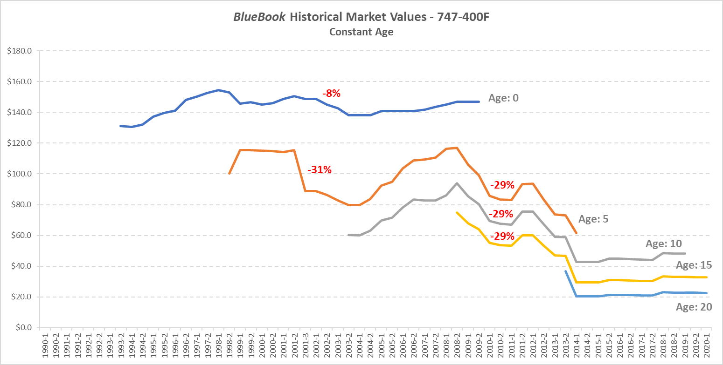
Constant Age Market Values – 747-400F

Slide 14
747-8F Current And Future Values (2015 Vintage)
In Millions
Market Value
Market Value equal to Base Value for next few years.
747-8F is not your typical aircraft that ends production (no replacement available). Nose loading capability and an operator base committed to the type will keep values reasonably firm for the foreseeable future.
Base Value

Slide 15
Value Impact Due To Covid-19

Slide 16
Comparison Of Forecast Market Values Before And After Pandemic

Slide 17
Feedstock Values For Emerging Conversion Types
2000 Vintages
Dollars in Millions
-24%
-24%
-35%
Source: AVITAS BlueBooks.

Slide 18
Summary
The aviation industry is experiencing the most severe global downturn in history.
We will likely need a few years to return to long-term Base Values for passenger aircraft.
Dedicated freighters are in short supply and values are holding firm.
The 747 will end production in 2022. Values for the 747-8F and 747-400F should perform well due to the nose-loading capability.

