Slide 1

The Impact of COVID-19 on Aircraft Values
Doug Kelly, Senior Vice President – Asset Valuation
AVITAS, Inc.
Cargo Facts Webinar
April 2, 2020
Notes:
1

Slide 2

Agenda
1
What’s Different About This Crisis?
2
Value Trends During Past Cycles
3
Forecasting Values Post-Crisis
4
Feedstock Values for Emerging Conversion Types:
737NGs, A321s, and A330s

Slide 3
Past Cycles from 1990
Negative RPK growth three times: 1991, 2001, 2009

Slide 4
TSA Traveler Checkpoint Numbers – March 2019 vs March 2020
93% drop in travelers from last year
2019
2020
Source: Transportation Security Administration

Slide 5
AVITAS’s Estimate Of This Cycle vs. Past Cycles
This time the fall in passenger traffic is much more severe

Slide 6
Differences In This Downturn Compared To The Past
Recessions
1990
High fuel price
Threat of terrorism
Massive overbooking
Iraq War I
Pax Traffic declined:
2.6% (1991)
2001
High fuel price
Real terrorism
Grounding of US aircraft
Iraq War II
Airline bankruptcies
Bali bombing
SARS
$Billions Govt Stimulus
Pax Traffic declined:
2.4%
2008
High fuel price
Financial collapse
Mortgage crisis
Financing available for new aircraft
Export credit
$Billions Govt stimulus
Pax Traffic declined:
1.7% (2009)
2020
Low fuel price
Record backlogs
Slowdown
MAX grounding
Pandemic
Forced shutdown of businesses worldwide
Global recession
$Trillions Govt stimulus
Pax Traffic declined:
62%

Slide 7
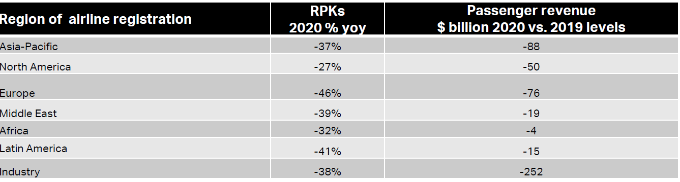
2020 Will Be The Largest Decline In RPKs Ever
AVITAS projects a 62% decline in RPKs in 2020 far greater than IATA’s 38% fall below.
IATA’s projections are understating the decline because they assume travel restrictions only through Q2
Source: IATA Economics, March 24, 2020

Slide 8
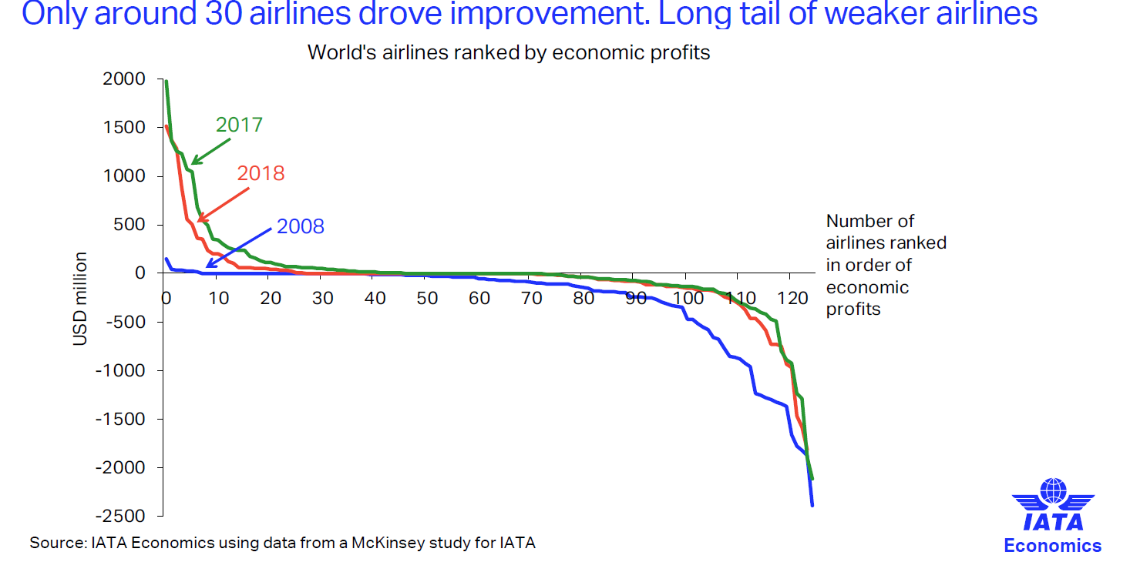
Airlines Fragile Even Before COVID-19

Slide 9
Trade War Was Impacting Air Cargo Traffic Before Pandemic
Beginning of Trade War
U.S. announced 10% tariff on China beginning end of September increasing to 25% by end of 2018. The increase was postponed until May 2019.
Note: highlighting indicates <0

Slide 10
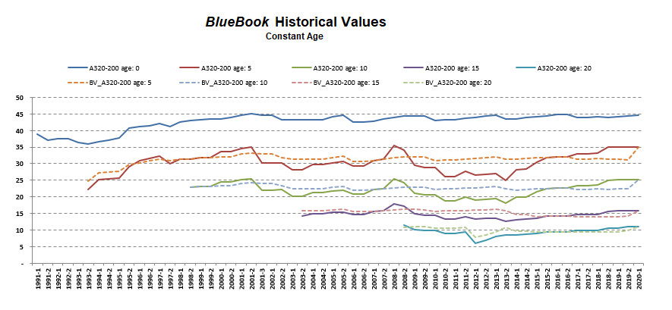
Constant Age Base and Market Values – A320-200
Generally, used A320 values dropped about 10-25% through the global downturns depending on the age, while the newer 737-800 values declined in the 10-12% range. The fall in values of out-of-production aircraft was significantly greater than in-production aircraft.

Slide 11
How To Forecast Values Now
Situation Analysis:
We know values have declined significantly for most types
No current transactions happening to provide guidance
However, AVITAS does have:
Historical BlueBook values from 1990 to present
Over 10,000 historical transactions from 1970 to present for use in our proprietary quantitative models
An extensive network of industry contacts
Solution:
Use historical Bluebook Values, proprietary quantitative modeling approach, survey contacts, and use our own extensive industry experience

Slide 12
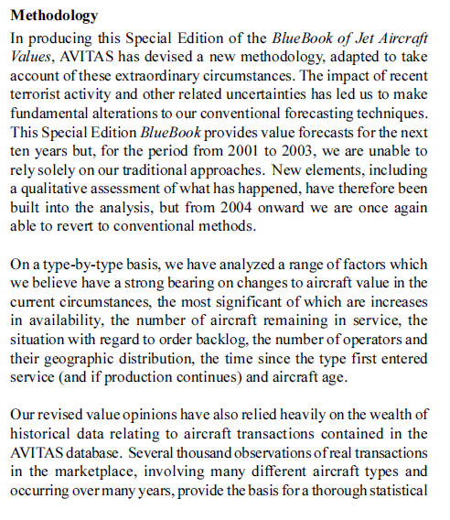
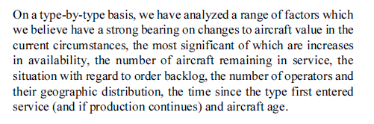
2001 Special Edition BlueBook - Methodology

Slide 13
Feedstock Values for Emerging Conversion Types
2000 Vintages
Dollars in Millions
-20%
-20%
-25%
Source: AVITAS BlueBook and estimates.

Slide 14
Summary
The aviation industry is experiencing the most severe global downturn in history.
Fiscal stimulus will moderate downturn and accelerate the recovery.
We will likely need a few years to return to long-term Base Values.
AVITAS is using historical values, proprietary quantitative modeling, and our own extensive experience to prepare a Special Edition BlueBook for publication in May 2020.

