Slide 1
e-Commerce
Brendan Sullivan
Head, E-Commerce & Cargo Operations
sullivanb@iata.org

Slide 2
Consumer behavior changed in 2020
Worldwide E-Commerce will reach $5 Trillion in 2021
27.6 %
24 %
Growth of worldwide e-commerce retail sales, for a total of USD 4.280 trillion
jump in e-commerce transactions in December 2020 compared to 2019
81 %
61 %
of consumers would prefer carbon neutral delivery
of consumers would prefer sustainable packaging
% of total retail sales

Slide 3
E-Commerce Global Distribution - 2019
UK
$79B
Russia
$19B
Japan
$89B
US
South Korea
$66B
$365B
China
France
$723B
$43B
Germany
$74B
Australia
$21B
Source: Statista
* Figures currently including services, already identified source for potentially excluding services, at sales levels, potential to include share of the top-50 players by country
Notes:
“However, growth is uneven, with some countries capitalizing on it more than others”
US and China are the biggest e-commerce markets (for selected categories) due to a number factors:
Population
Total GDP
Manufacturing capabilities
Internet penetration
Both of countries create opportunities for cross border as well as domestic Air Cargo. In addition, the connection between those regions comprises the largest international Air Cargo route.
Emerging markets can also pose an opportunity for cross border e-commerce growth in the next decade.

Slide 4
Pandemic Period e-Commerce Growth
COVID-19 has grown E-Commerce exponentially across the world, especially in the U.S., Latin America, Europe and China
3 years ahead
2 years ahead
United States
5 years ahead
China
Latin America
Notes:
“However, growth is uneven, with some countries capitalizing on it more than others”
US and China are the biggest e-commerce markets (for selected categories) due to a number factors:
Population
Total GDP
Manufacturing capabilities
Internet penetration
Both of countries create opportunities for cross border as well as domestic Air Cargo. In addition, the connection between those regions comprises the largest international Air Cargo route.
Emerging markets can also pose an opportunity for cross border e-commerce growth in the next decade.

Slide 5
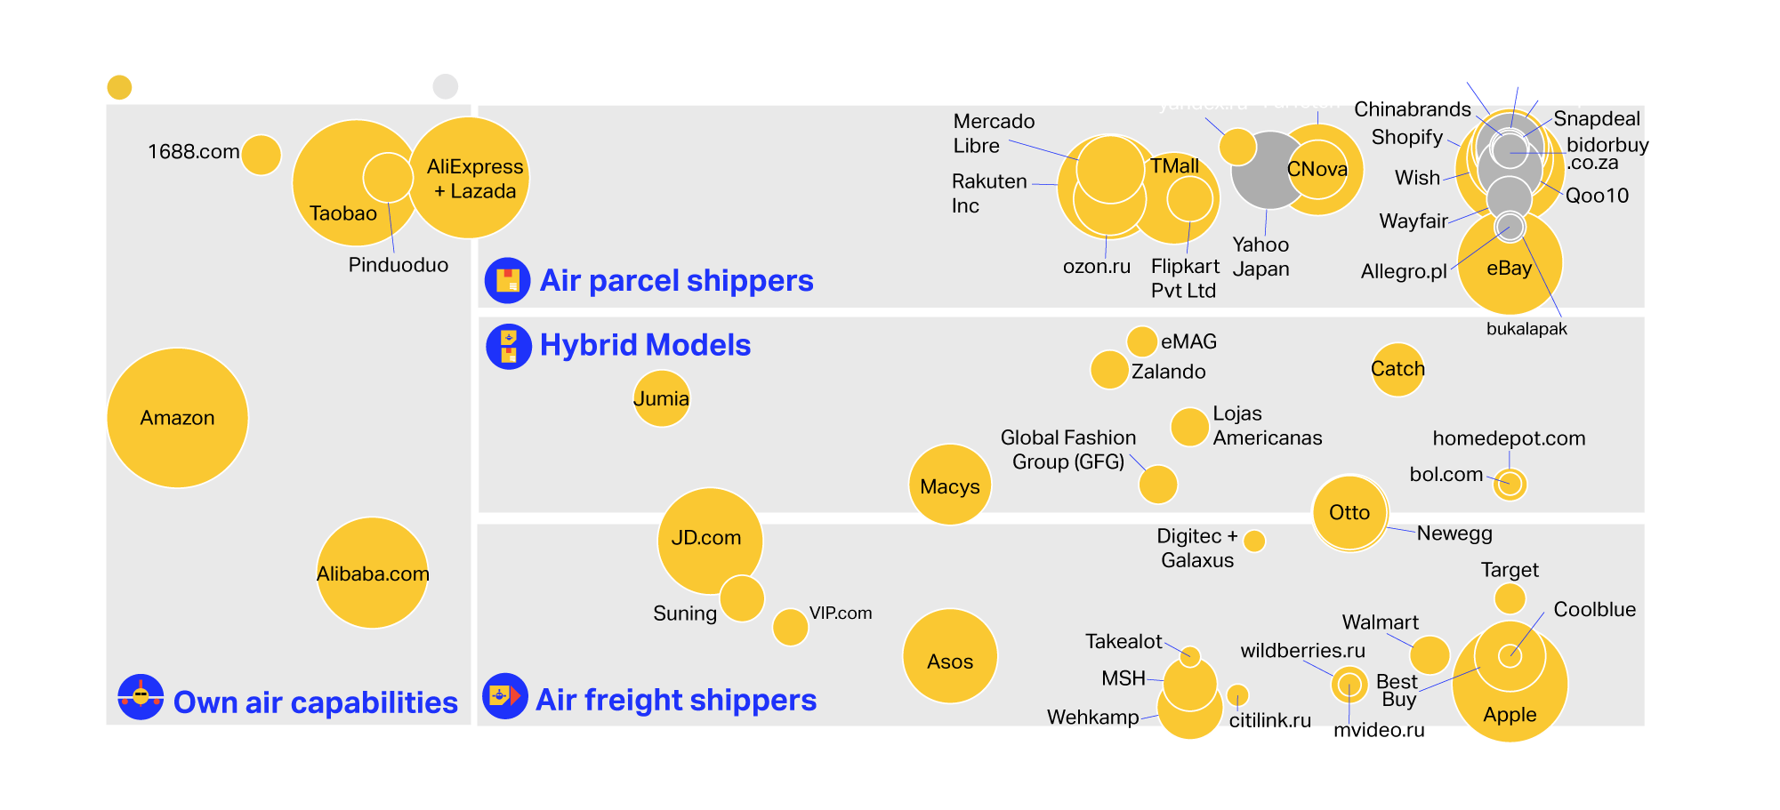
Air cargo models & e-tailers
Owned and fully dedicated air transport capabilities
Firms reduce their dependence on 3rd party carriers, limiting risks and increasing margins.
Air freight shippers
Companies move the goods to fulfillment centers in freight format and perform local ground distribution in the destination country
Hybrid model
Mixed-use of internal and external capabilities to move freight to fulfillment centers, and also shipping of single parcels to consumers via air cargo
Air parcel shippers
Firms rely on standard Courier-Express-Parcel & airmail. It is common for marketplaces due to their high dispatch fragmentation
mvideo.ru

Slide 6
Air cargo e-commerce models
Model 1:
Owned and fully dedicated air transport capabilities
Model 2: Air freight shippers
Model 3: Hybrid models
Model 4:
Air parcel shippers (traditional model)
Firms using owned air transport capabilities reduce their dependence on 3rd party carriers in order to limit risk and increase margins along the cross-border e-Commerce value chain.
More prevalent among large players, though elements of this model are often mixed to some extent with models 2-4.
Amazon owns Amazon Air which is expanding its fleet, planning to reach 70 aircraft by 2021.
Cainiao, the logistics arm of the Alibaba Group, outsources its air transport but uses dedicated capacity to do so.
Moving goods to fulfillment centers in freight format (rather than single parcels) and performs local ground distribution in target country (can be own or outsourced).
Traditional model for future-domestic*** cargo
More common for large online shops (e.g. ASOS, JD.com, Wehkamp or Apple) than marketplaces, who often have their own fulfillment and/or distribution centers. This way of moving goods is also less costly than moving single parcels.
Main routes are Far East to Europe and North America, and intra-continent.
Mixed use of dedicated and external capabilities for moving freight to fulfillment centers and single parcels (loose dispatch) to consumers via air cargo.
Popular among firms operating as both an e-shop and marketplace e.g. Zalando
Hybrid models benefit from reduced air freight costs and high service levels when needed, while maintaining revenues from marketplace cooperation with small sellers who dispatch single parcels on their own
Allows flexibility of transportation capacity, e.g in case of seasonality
Traditional model of cross-border e-commerce players relying on standard CEP and postal air cargo, e.g. Wish, Shopify
More common for marketplaces due to high dispatch fragmentation as they are usually sent for individual orders
This model allows online stores to focus on marketing and other essential business operations, specializing and outsourcing T&L
Popular regardless of region as services provided by CEP and postal air cargo are available worldwide
Driven by UPU regulations***
Notes:
4 distinct air cargo logistics models were identified, distinguishable by variations in the level of owned vs. outsourced capability and the air dispatch/consolidation profile (single parcels vs. freight)

Slide 7
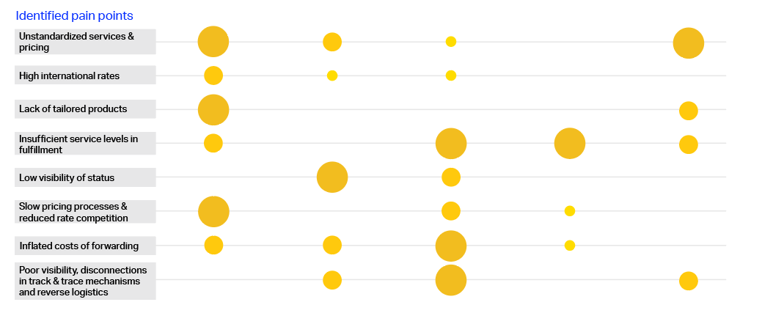
Five strategies for transformation
Focus on e-commerce products & services
Digitize to increase speed
Build into own system
Shift to cargo
Compete through responsiveness and VAS
80 %
of cross border e-commerce is transported by air
36 %
air cargo airline revenue in 2020
82 %
of consumers want recyclable packaging
Notes:
As part of our research, IATA engaged with many e-commerce players to identify how to transform the pain points into opportunities. And depending on the degree to which they wish to enter the market, they could then adopt one or more of the following strategies illustrated below. Read more about the 5 strategies in the latest insights article (pdf)
78% of consumers wanted reusable packaging
12 million parcels were packaged using Cainiao’s smart-packaging algorithms during 11.11.2020

Slide 8
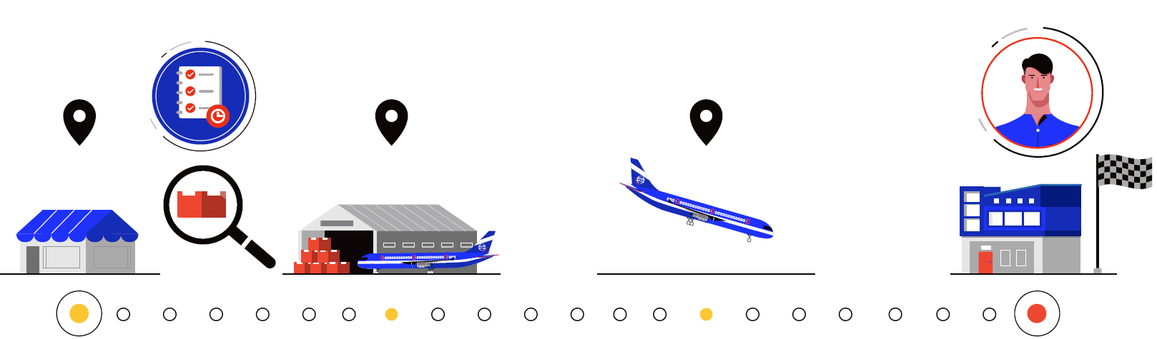
Transform to build a robust air cargo
COVID-19 has accelerated e-commerce penetration and solidified the shift in consumer behavior.
carriers need to address existing pain points through the 5 strategies in order to adapt to e-tailers needs
e-commerce is key for industry prosperity/survival
Notes:
In order to capitalize on the demand and embrace the opportunity that air cargo has during this pandemic, it is critical that we build a robust air cargo strategy. In order to do this, we must examine the pain points in order to transform the industry.

Slide 9
Thank you
More information, insight articles and the IATA e-Commerce Monitor are available at www.iata.org/ecommerce
Brendan Sullivan
Head, E-Commerce & Cargo Operations
sullivanb@iata.org

